Slide 1
Lecture 16
AC Circuit Analysis (1)
Hung-yi Lee

Slide 2
Textbook
Chapter 6.1

Slide 3
AC Steady State
Second order circuits:
If the circuit is stable:
As t → ∞
Steady State
In this lecture, we only care about the AC steady state
Source:

Slide 4
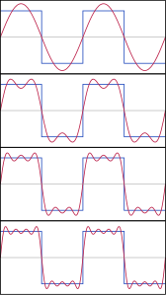
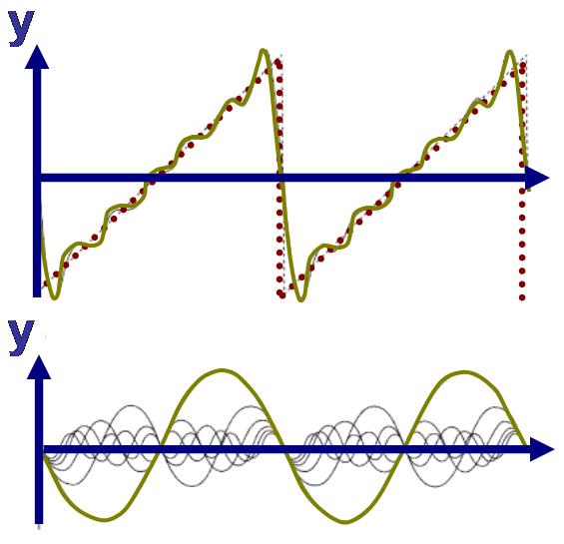
AC Steady State
Why we care about AC steady state?
  Fourier Series/Fourier Transform
Notes:
exp

Slide 5
AC Steady State
Why we care about AC steady state?
  Fourier Series/Fourier Transform
  Most waveforms are the sum of sinusoidal waves with different frequencies, amplitudes and phases
  Compute the steady state of each sinusoidal wave
  Obtaining the final steady state by superposition

Slide 6
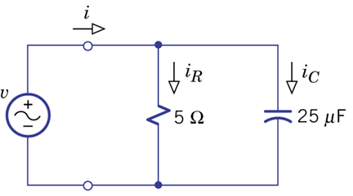
Example 6.3

Slide 7
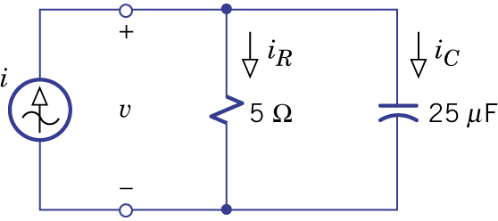
Example 6.4

Slide 8
Example 6.4

Slide 9
AC Steady-State Analysis
Example 6.3
Example 6.4
Notes:
Do you find anything?
未看先猜

Slide 10
AC Steady-State Analysis
AC steady state voltage or current is the special solution of a differential equation.
AC steady state voltage or current in a circuit is a sinusoid having the same frequency as the source.
  This is a consequence of the nature of particular solutions for sinusoidal forcing functions.
To know a steady state voltage or current, all we need to know is its magnitude and its phase
  Same form, same frequency

Slide 11
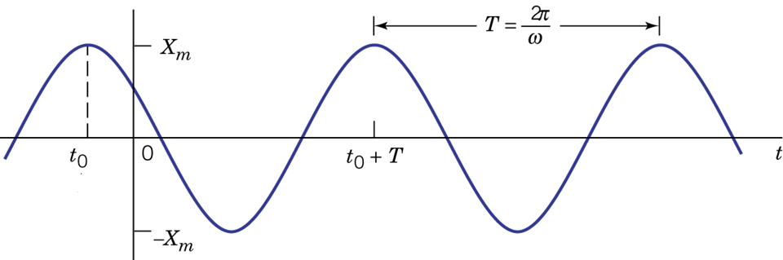
AC Steady-State Analysis
For current or voltage at AC steady state, we only have to record amplitude and phase
Amplitude: X_{m}
Phase: ϕ
Notes:
Do not worry about sine

Slide 12
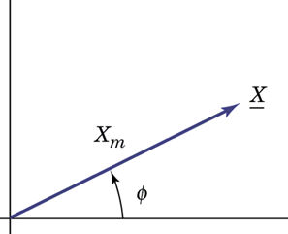
Phasor
A sinusoidal function is a point on a x-y plane
Polar form:
Rectangular form:
Exponential form:

Slide 13
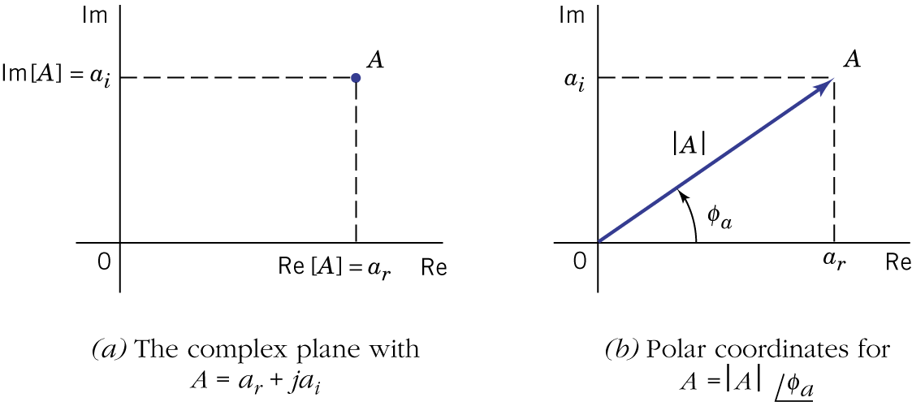
Review
– Operation of Complex Number
A is a complex number

Slide 14
Review
– Operation of Complex Number
A is a complex number
  rectangular ⬄ polar:

Slide 15
Review
– Operation of Complex Number
A is a complex number
  Complex conjugate:

Slide 16
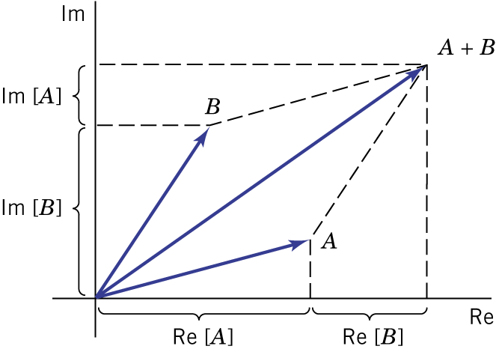
Review
– Operation of Complex Number
Addition and subtraction are difficult using the polar form.

Slide 17
Review
– Operation of Complex Number

Slide 18
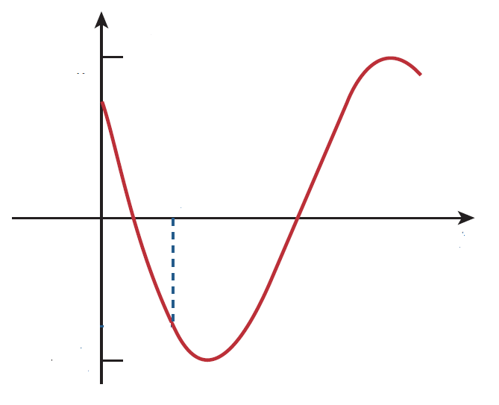
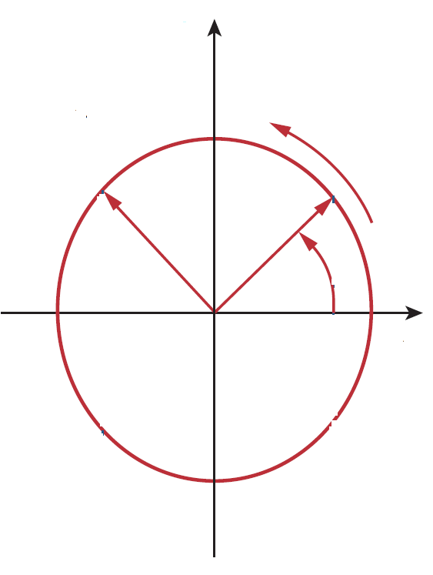
Phasor
Sinusoid function:
Phasor:
It is rotating.
At t=0, the phasor is at
Its projection on x-axis producing the sinusoid function

Slide 19
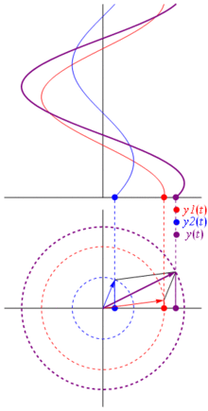
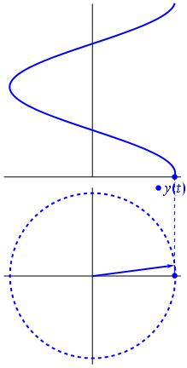

Slide 20
Phasor - Summation
KVL & KCL need summation
Textbook, P245 - 246
Notes:
Using Euler’s Formula P245 - 246

Slide 21
KCL and KVL for Phasors
KCL
input current
output current
KVL
voltage rise
voltage drop
Phasors also satisfy KCL and KVL.
Notes:
P1293

Slide 22
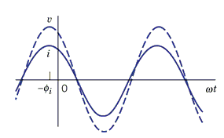
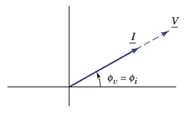
Phasor - Multiplication
Time domain
Phasor
Multiply k
Multiply k

Slide 23
Phasor - Differential
We have to differentiate a sinusoidal wave due to the i-v characteristics of capacitors and inductors.
Differentiate
Multiplying jω

Slide 24
Phasor - Differential
We have to differentiate a sinusoidal wave due to the i-v characteristics of capacitors and inductors.
Time domain
Phasor

Slide 25
Phasor - Differential
We have to differentiate a sinusoidal wave due to the i-v characteristics of capacitors and inductors.
Phasor
Equivalent to multiply jω
Multiply ω
Rotate 90。
Differentiate on time domain = phasor multiplying jω
Notes:
a+jb sqrt(a^2+b^2) tan-1(b/a) ……
jaw - wb w*sqrt(a^2+b^2) tan-1(-a/b) ……

Slide 26
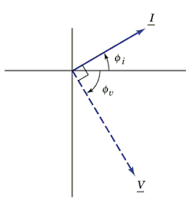
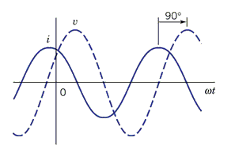
Phasor - Differential
i leads v by 90。
Capacitor
Time domain
Phasor

Slide 27
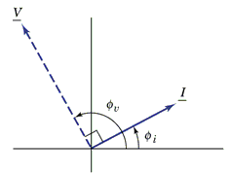
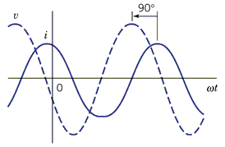
Phasor - Differential
v leads i by 90。
Inductor
Time domain
Phasor

Slide 28

Capacitor & Inductor
For C, i leads v
but v leads i for L

Slide 29
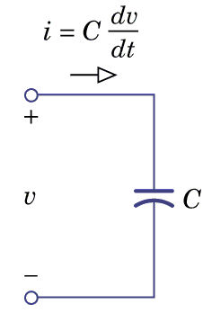
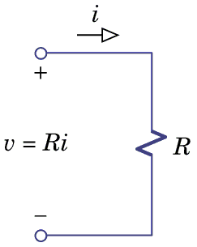
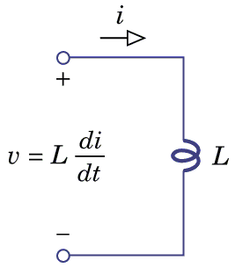
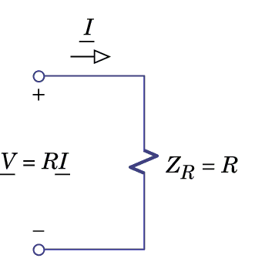
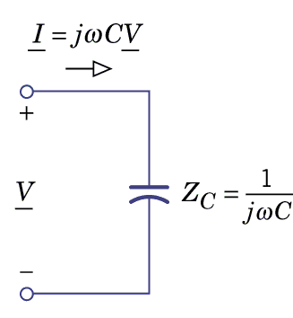
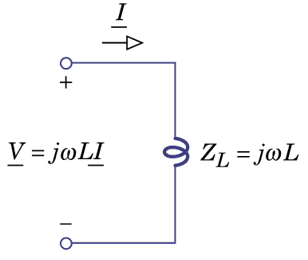
i-v characteristics
Time domain
Phasor
Phasors satisfy Ohm's law for resistor, capacitor and inductor.

Slide 30
i-v characteristics
  Impedance
Resistor
Capacitor
Inductor
  Admittance is the reciprocal of impedance.
Notes:
Unit of impedance

Slide 31
  Equivalent impedance and admittance
Series equivalent impedance
Parallel equivalent impedance

Slide 32
Impedance
After series and parallel,
the equivalent impedance is
Resistor
Capacitor
Inductor
Inductors and capacitors are called reactive elements.
Inductive reactance is positive, and capacitive reactance is negative.

Slide 33
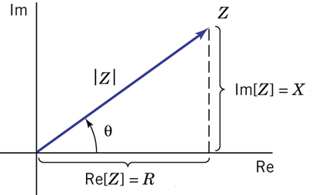
Impedance Triangle
After series and parallel,
the equivalent impedance is

Slide 34
AC Circuit Analysis
1. Representing sinusoidal function as phasors
2. Evaluating element impedances at the source frequency
  Impedance is frequency dependent
3. All resistive-circuit analysis techniques can be used for phasors and impedances
  Such as node analysis, mesh analysis, proportionality principle, superposition principle, Thevenin theorem, Norton theorem
  4. Converting the phasors back to sinusoidal function.

Slide 35
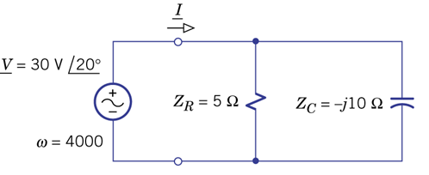
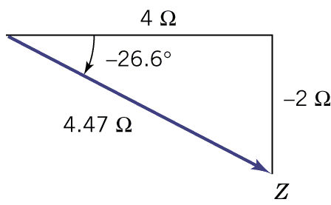
Example 6.6

Slide 36
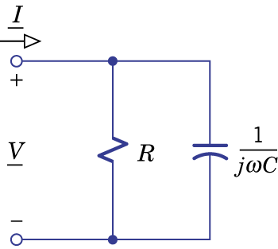
Example 6.7
Impedance is frequency dependent
Find equivalent network
Z_{eq} should be Z_{eq}(ω) or Z_{eq}(jω)

Slide 37
Example 6.7
Impedance is frequency dependent
Find equivalent network
If ω → 0
For DC, C is equivalent to open circuit
If ω → ∞
C becomes short

Slide 38
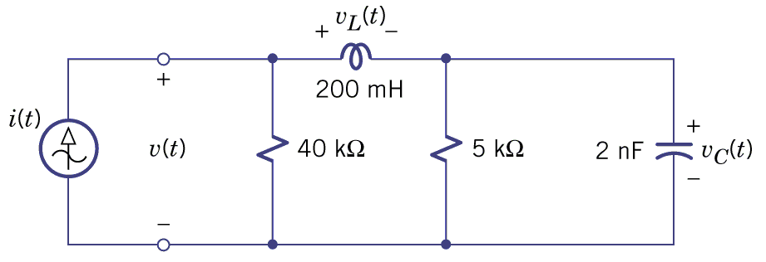
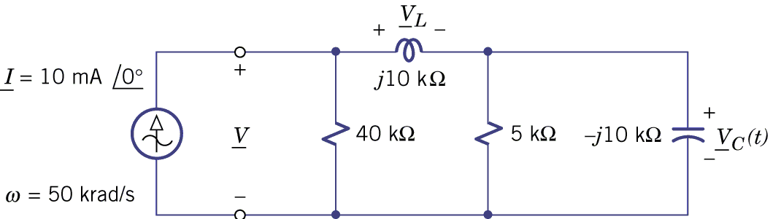
Example 6.8
Find v(t), v_{L}(t) and v_{C}(t)

Slide 39
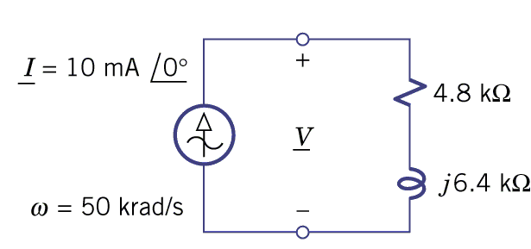
Example 6.8
Z_{eq} = 4.8kΩ
+ j6.4k Ω

Slide 40
Example 6.8
Z_{eq} = 4.8kΩ
+ j6.4k Ω

Slide 41

Example 6.8

Slide 42
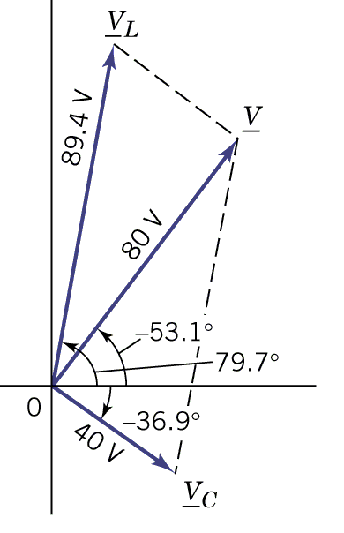
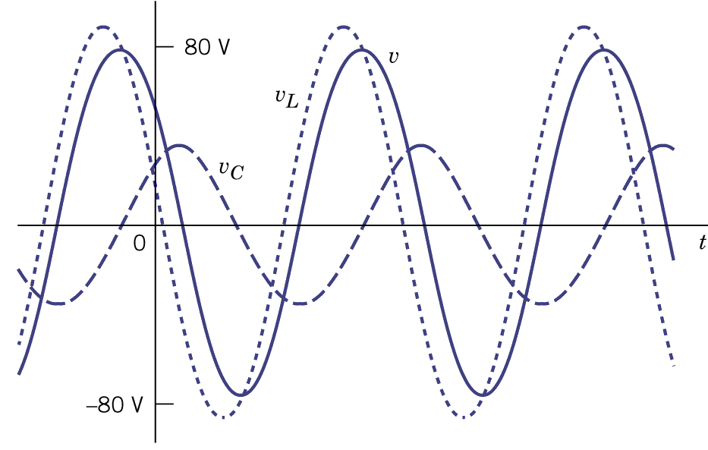
Example 6.8

Slide 43
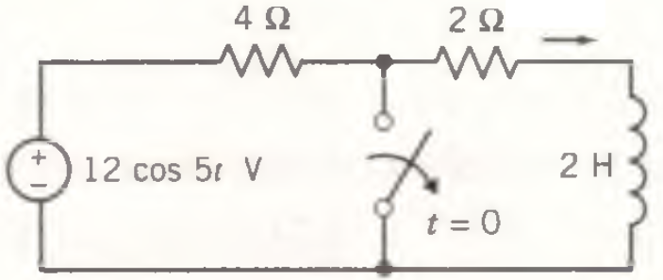
Complete Response

Slide 44
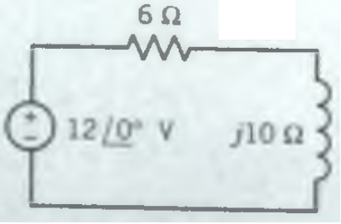
Complete Response
Reach steady state
Forced
Response

Slide 45
Complete Response
Natural Response:

Slide 46
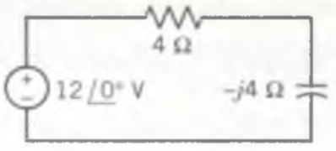
Complete Response

Slide 47
Complete Response
Initial Condition:

Slide 48
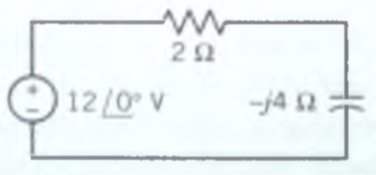
Complete Response
Reach steady state
Forced
Response

Slide 49
Complete Response
Natural Response:

Slide 50
Complete Response
Summarizing the results:

Slide 51


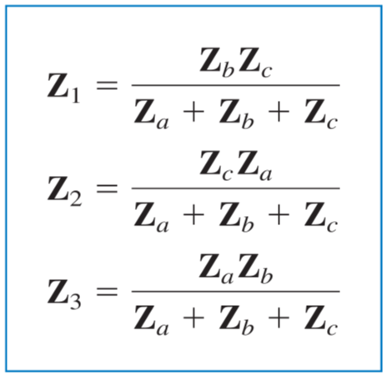
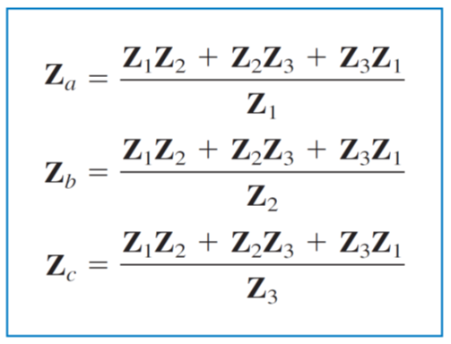
Three Terminal Network

Slide 52
Homework
6.20
6.22
6.24
6.26
6.36 (b)

Slide 53
Thank you!

Slide 54
Answer
6.20: 10, 0.002
6.22: Z=10Ω, v=40cos500t, i1=5.66cos(500t-45。), i2=4cos(500t+90。)
6.24:Z=7.07<-45, i=1.41cos(2000t+45 。), vc=14.1cos(2000t-45。), v1=10cos(2000t+90。)
6.26:Z=18 Ω, v=36cos2000t, iL=2cos(2000t-90。), i2=2.83cos(2000t+45。)
6.36 (b): L=12mH

